Slide 1
Gulp – A task runner

Slide 2
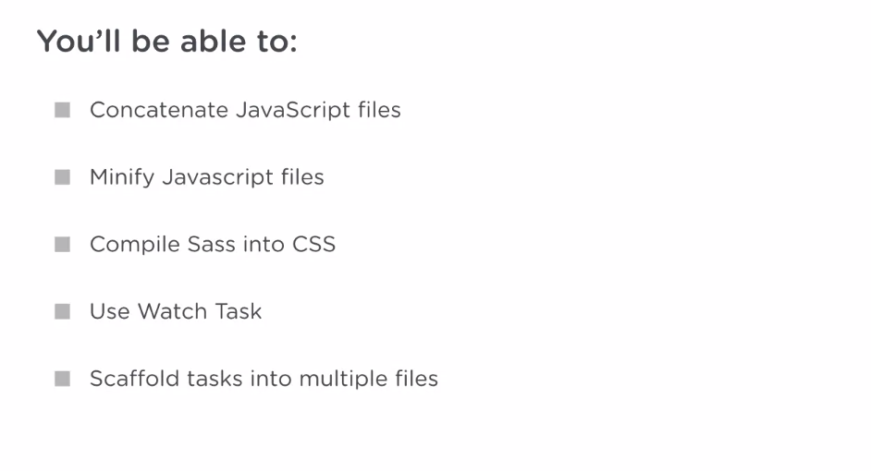

Slide 3
Why Gulp
Gulp is the engine that can run individual, predefined tasks.
And these tasks could be just about anything from compiling Sass to CSS and serving these files in development to minifying CSS and JavaScript to create smaller files for production environments.
Tasks are typically defined in a JavaScript file or set of files.

Slide 4
Why Gulp
These tasks can then be called and run by the Gulp engine and these tasks can run one after the other, where later tasks depend on the earlier tasks.
Tasks can also be run all at the same time in parallel.
For instance, Gulp can concatenate scripts at the same time it compiles Sass into CSS. This is because the two tasks don't depend on each other at all.
Notes:
We'll refer to the task setups as pipelines. Gulp is used to manage some pretty sophisticated task pipelines.

Slide 5
Installing Gulp
Gulp is a Node.js technology and so, you need Node and Node package manager installed on your machine.
To see if Node and npm are installed, you can run
node -v
npm -v
I can use Node's HTTP server from the project directory.
run “http-server”
If you don’t have http-server run “npm install -g http-server”
It’s recommended to change the port to 3000 using -p flag
http-server -p 3000
Notes:
And, this serves a site on port 8080 on my machine. But, it's more conventional to serve Node applications on port 3000. So, I'll add the p flag and the 3000 option to serve the site on port 3000.

Slide 6
Installing Gulp
gulp is a Node module and in order to add gulp to our project, we have to create a package.json file that lists the project's Node dependencies.
The package.json file also contains information, like the version of our project and the URL for the GitHub repo, where the project is. Let's create the package.json file by running the command npm init.
Let's install gulp by running npm install gulp --save-dev
Notes:
Gulp is not used by our app directly and in fact, the app does not need gulp to run. Our application is a static website of JavaScript and styles, and can be run by any static server. gulp will almost never need to be installed on our production servers. Therefore, we list it as a development-only dependency.

Slide 7
Installing Gulp Globally
You'll also want to install gulp globally by running npm install --global gulp.
The reason we installed globally is so that it's available system wide. The system wide installation of gulp will manage the local dependencies of gulp in each of your projects.

